Slide 1
Peregrine
Nathan Justice
DATS 6501 - Capstone

Slide 2
Roadmap
1
2
3
4
5
Introduction
Literature Review
Methodology
Results
Conclusion
Background
Problem Statement
Motivation
Problem Elaboration
Project Scope
Relevant Research
Dataset Description
Data Collection
Data Preprocessing
Data Exploration
Feature Engineering
ETL Pipeline
Project Limitations
Future Work
Demo
References

Slide 3
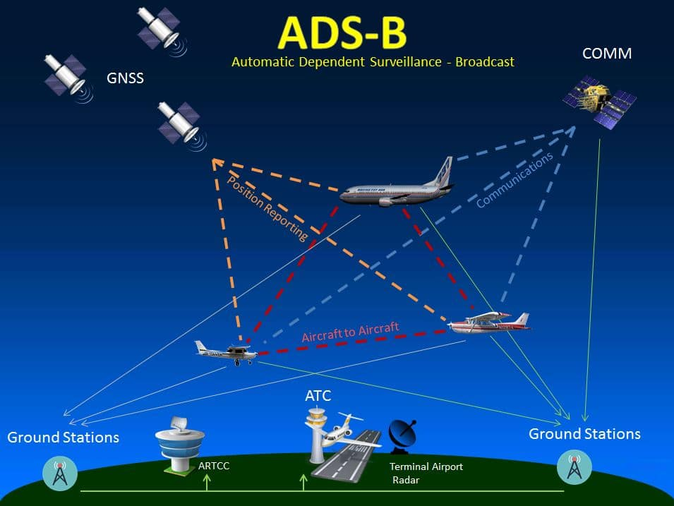
1
Introduction
Background
Problem Statement
Motivation
Problem Elaboration
Project Scope

Slide 4
1
Introduction
Despite the abundance and accessibility, ADS-B data are often messy, incomplete, and difficult to use in their raw form. By implementing fixes to the data quality, useful tools can be developed to facilitate analysts' investigation into projects involving aircraft and airspace travel.
Background
Problem Statement
Motivation
Problem Elaboration
Project Scope

Slide 5



1
Introduction
Background
Problem Statement
Motivation
Problem Elaboration
Project Scope
C4ADS is a "nonprofit organization dedicated to providing data-driven analysis and evidence-based reporting on global conflict and transnational security issues".

Slide 6
1
Improve the quality of the existing ADS-B data and engineer new features woefully lacking in its current form
Develop an application informed by user-stories that will facilitate the way C4ADS analysts utilize ADS-B data
Implement features that allow client-specific questions to be investigated
Introduction
Background
Problem Statement
Motivation
Problem Elaboration
Project Scope

Slide 7
1
Introduction
Background
Problem Statement
Motivation
Problem Elaboration
Project Scope
Data availability began June 9th, 2016
~10 GB of data per day
~13 Terabytes
Approximating global coverage

Slide 8
2
Literature Review
Relevant Research
Data quality issues: speed and altitude
Data anomalies: GPS coordinates

Slide 9
3
Methodology
Dataset Description
Data Collection
Data Preprocessing
Data Exploration
Feature Engineering
Records of pings
37 features
Unreliable information: on ground & source/destination
“Based on user-reported routes, and is quite often wrong. Don’t depend on it.”

Slide 10
3
Methodology
Dataset Description
Data Collection
Data Preprocessing
Data Exploration
Feature Engineering
ADSBexchange Redshift database
Global DEM
Global airport dataset

Slide 11
3
Methodology
Dataset Description
Data Collection
Data Preprocessing
Data Exploration
Feature Engineering
Feature encoding: altitude, speed, trak, vertical speed
Height calculation
Airport buffers

Slide 12
3
Methodology
Dataset Description
Data Collection
Data Preprocessing
Data Exploration
Feature Engineering
Landing heuristic: speed, height, vertical speed
Flight heuristic: measured distance traveled vs inferred distance traveled over time

Slide 13
3
Methodology
Dataset Description
Data Collection
Data Preprocessing
Data Exploration
Feature Engineering
Is on ground
Is at airport
Which airport
Flight identification

Slide 14
4
Extract
Transform
Load
Results
ADSB
PostGIS
Feature encoding
Height
Is on ground
Is at airport
Which airport
Flight identification
ADSB+
ETL Pipeline
ADSB
Flights
Airports
Flights
Production
Temporal bounds
Source + Destination
Non-airport take off + landings
Airports+
DEM

Slide 15
5
Conclusion
Need more computational power
AWS Glue
Confined access
PySpark environment limitations
Restricted to tabular data structures
Daily updates
Project Limitations
Future Work
Demo
References

Slide 16
5
Conclusion
Project Limitations
Future Work
Demo
References
Automated cloud pipeline
Bolstering heuristics and augmentations over time
Additional app development

Slide 17
5
Conclusion
Project Limitations
Future Work
Demo
References
http://ec2-35-172-177-205.compute-1.amazonaws.com/workbook

Slide 18
5
Conclusion
Project Limitations
Future Work
Demo
References
Tesi, S., & Pleninger, S. (2017). Analysis of Quality Indicators in ADS-B Messages. MAD-Magazine of Aviation Development, 5(3), 6-12.
Syd Ali, B., Schuster, W., Ochieng, W. et al. (2016). Analysis of anomalies in ADS-B and its GPS data. GPS Solut 20: 429.
ROUTES (Reducing Opportunities for Unlawful Transport of Endangered Species). In Plane Sight, Wildlife Trafficking in the Air Transport Sector.

Slide 19

?
Questions

